Slide 1


ADHI COLLEGE OF ENGINEERING AND TECHNOLOGY
Department of Electronics and
Communication Engineering
Final Review
DATE:10.05.2024

Slide 2
IMPROVING VERIFICATION EFFICIENCY WITH VIRTUAL SEQUENCE USING UNIVERSAL VERIFICATION METHODOLOGY
Team Members Name of Supervisor
BALAJI S (410120106014) Mrs. RUPADEVI N
GOMATHI P (410120106024) AP/ECE
JEEVA V (410120106029)
SANGEETHA R (410120106063)

Slide 3
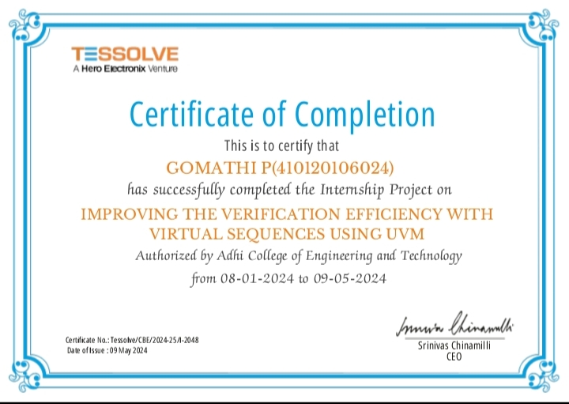
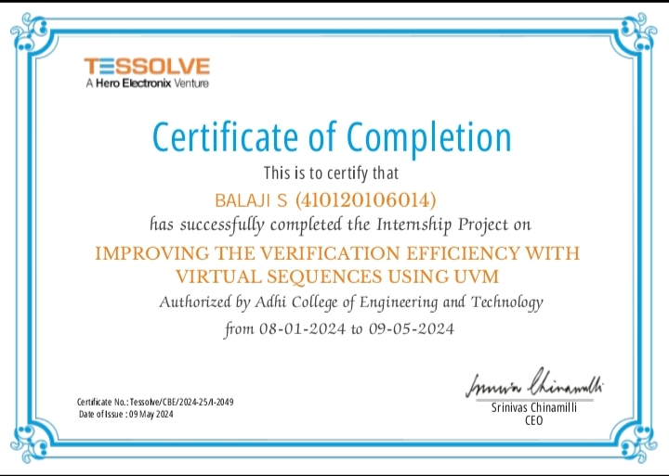
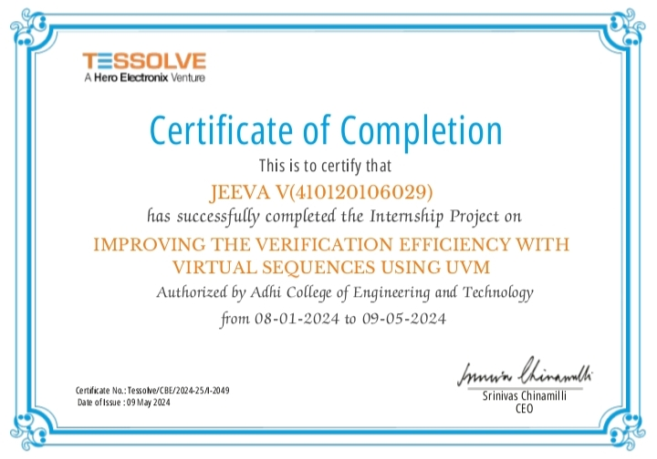
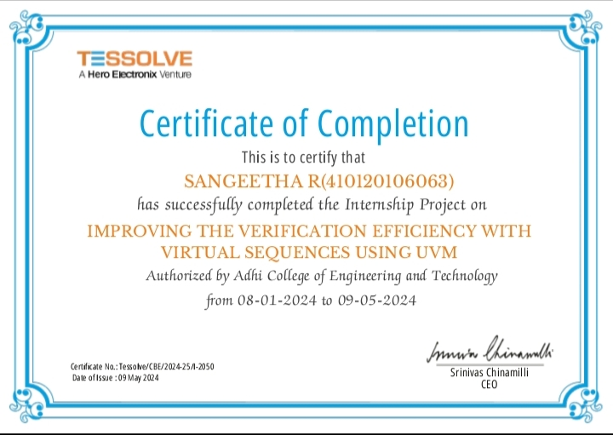
TESSOLVE INTERNSHIP CERTIFICATE

Slide 4
AGENDA
Abstract
Introduction
Literature Survey
Problem Statement
Existing System
Proposed System
FIFO Diagram
Architecture
9. Execution of UVM Phases
10. Software Components
11. Advantages
12. Applications
Ouput Waveform
Conclusion
References

Slide 5
ABSTRACT
The verification of complex digital designs is further compounded when dealing with specific components like FIFO(First-In-First-out) memory modules. These modules are integral to data processing and communication systems. Within the Universal Verification Methodology(UVM) framework, virtual sequences play a vital role in addressing these challenges. By explores the master-slave concept using virtual sequences for FIFO module verification. Virtual sequences for FIFO module verification ,we enable the creation of intricate test scenarios specifically to emulate the read and write operations of FIFO memory modules automating the verification process to enhance productivity, accuracy, and reduce time-to-market. Thus , while UVM provides a robust frame work for system-level verification, the application of virtual sequences to FIFO modules is crucial for ensuring the reliability and functionality of digital designs.

Slide 6
INTRODUCTION
The development and implementation of a comprehensive verification environment utilizing the Universal Verification Methodology (UVM) framework
The primary objective is to verify complex digital designs, with a specific emphasis on the operation of FIFO (First-In-First-Out) memory modules. To address the challenges associated with intricate data storage and retrieval mechanisms inherent in FIFO memory modules, we employ a master-slave concept.
The master component is responsible for write operations, while the slave component handles read operations
Leveraging virtual sequences within the UVM framework, to automate the verification process, enhancing productivity, accuracy, and reducing time-to-market.

Slide 7
LITRATURE SURVEY
S.NO | AUTHOR NAME | TITLE | YEAR | DESCRIPTIONS
01 | Apoorva H.M and Dr. Kiran Bailey Journal: International Journal of Engineering Research & Technology (IJERT). | UVM based Design Verification of FIFO | 2020 | This dual port RAM allows simultaneous access of read and write port synchronous FIFO architecture.
02 | Bidisha Kashyap and V. Ravi Journal: National Science, Engineering and Technology Conference (NCSET) | Universal verification Methodology based verification of UART Protocol | 2020 | UART- Universal Asynchronous Receiver and transmitter is a hardware device which facilitates serial transmission and reception of data
03 | Hyuk Je Kwon, Myeonghoon Oh Won-ok Kwon Journal: International Conference on Electronic, Information and Communication (ICEIC). | Verification Of Inter-connect RTL Code For Memory-centric Computing Using UVM | 2021 | The verification using UVM to verify RTL code for a Gen-Z switch in a memory-centric computing system. For verifying the switch logic

Slide 8
S.NO | AUTHOR NAME | TITLE | YEAR | DESCRIPTIONS
04 | Deepika, Jayanthi K Murthy Journal: International Journal of Innovative Technology and Exploring Engineering (IJITEE). | Interrupt Enabled Priority Based Mater Slave communication using SPI Protocol | 2021 | This paper proposes the design of a priority-based master slave communication system using SPI Protocol that enables the system to operate using interrupts.
05 | Abhishek Jain and Richa Gupta Journal: International Journal of Advanced Research in Computer Science. | Expanding the UVM Register Model towards Automation and Simplicity of Use | 2017 | These sequences are very useful at IP level verification but at SoC level verification, these sequences take very long time to run.

Slide 9
PROBLEM STATEMENT
The verification of FIFO memory modules in modern digital designs presents a significant challenge due to their inherent complexity and critical role in data storage and retrieval.
Manual testbench creation and scenario definition are time-consuming, error-prone, and unable to provide sufficient coverage for exhaustive testing.

Slide 10
EXISTING SYSTEM
The existing system utilizes the UVM framework for FIFO memory module verification.
Verification is conducted using regular sequences, which are predefined sequences of events or transactions.
Regular sequences offer limited flexibility in modeling higher-level scenarios based on constraints and specifications.
Engineers manually define regular sequences, which can be time consuming and less adaptable to changes in the design.

Slide 11
PROPOSED SYSTEM
The proposed system integrates virtual sequences and a master-slave concept into the UVM verification environment for FIFO memory module verification.
Virtual sequences offer dynamic generation capabilities and flexibility in modeling higher-level scenarios based on constraints and specifications.
Virtual sequences and the master-slave architecture automate scenario generation, reducing manual effort and increasing efficiency.
The proposed system provides enhanced flexibility in adapting to changes or updates in the design.

Slide 12
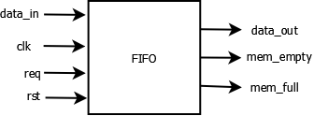
FIFO DIAGRAM

Slide 13
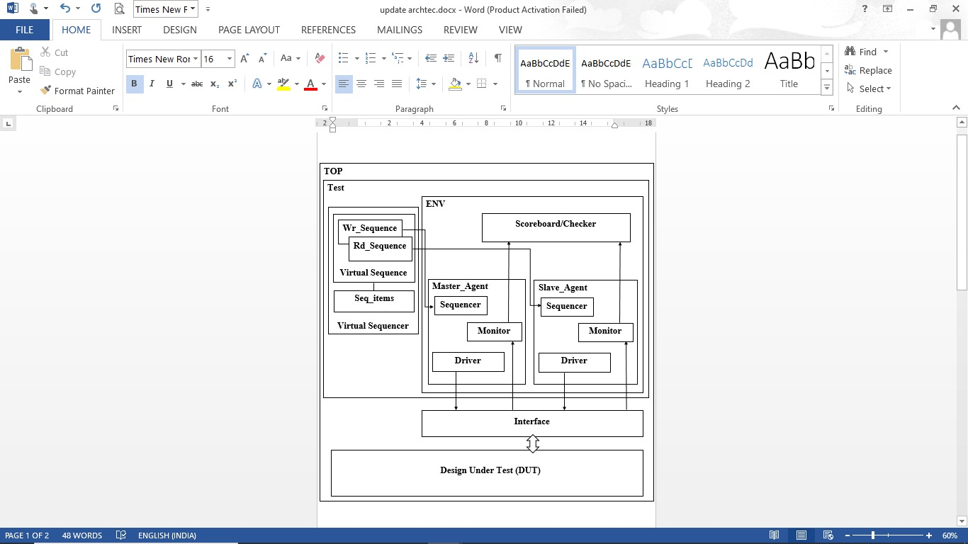
ARCITECTURE

Slide 14
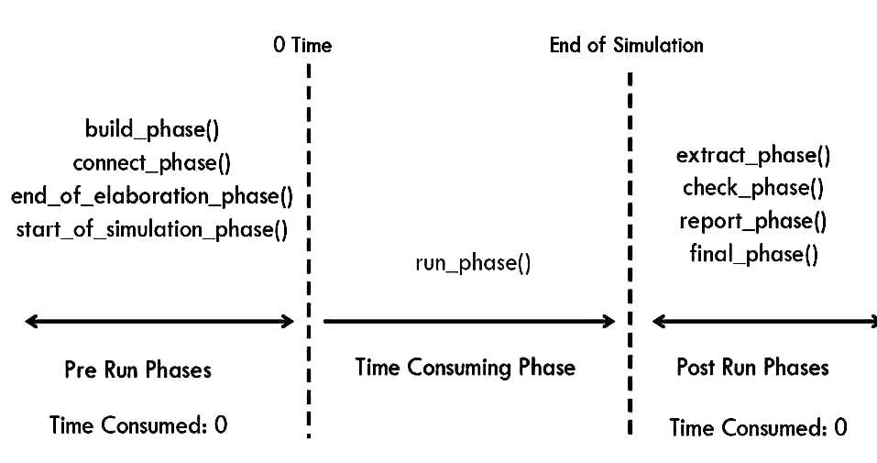
Execution Of UVM Phases

Slide 15

SOFTWARE COMPONENTS
EDA Playground
Synopsis VCS 2020.09 Simulator
Waveform Viewer

Slide 16
ADVANTAGES
Enhanced Flexibility
Automation
Scalability
Comprehensive Verification
Improved Coverage

Slide 17
APPLICATIONS
The proposed system with virtual sequences is applicable to various digital design verification.
Verification of FIFO memory modules.
System-on-chip (SoC) designs verification.
FPGA designs verification.
Digital Communication System.

Slide 18
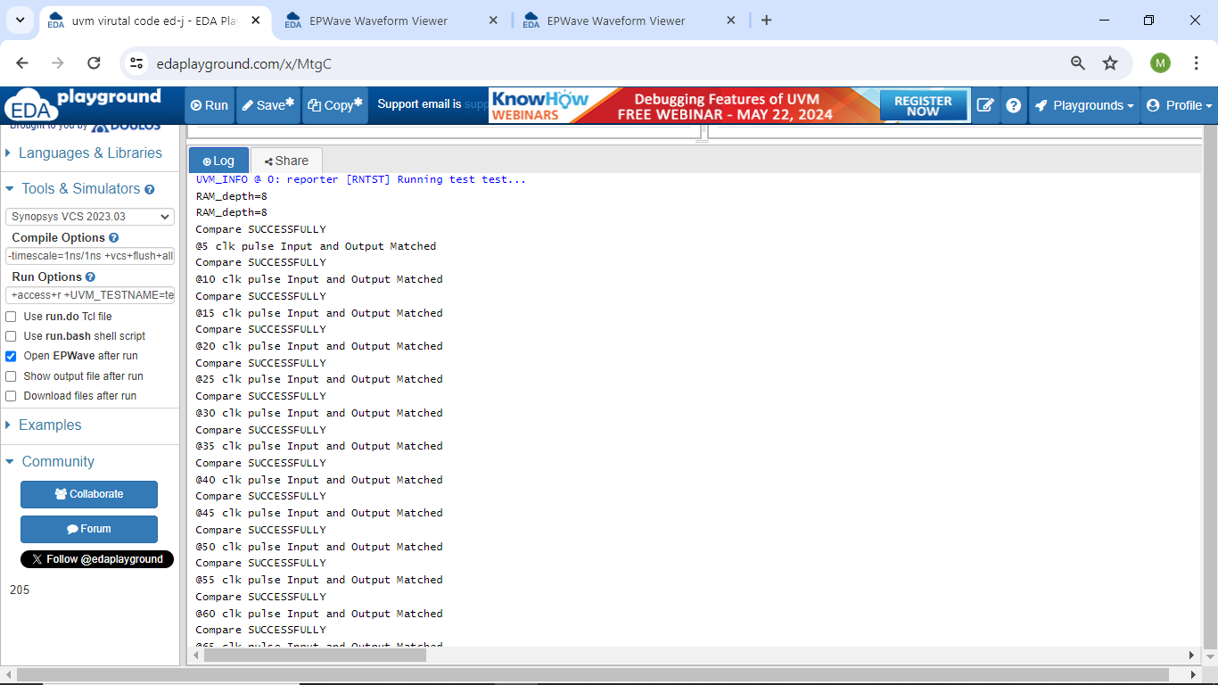
Simulation Result

Slide 19
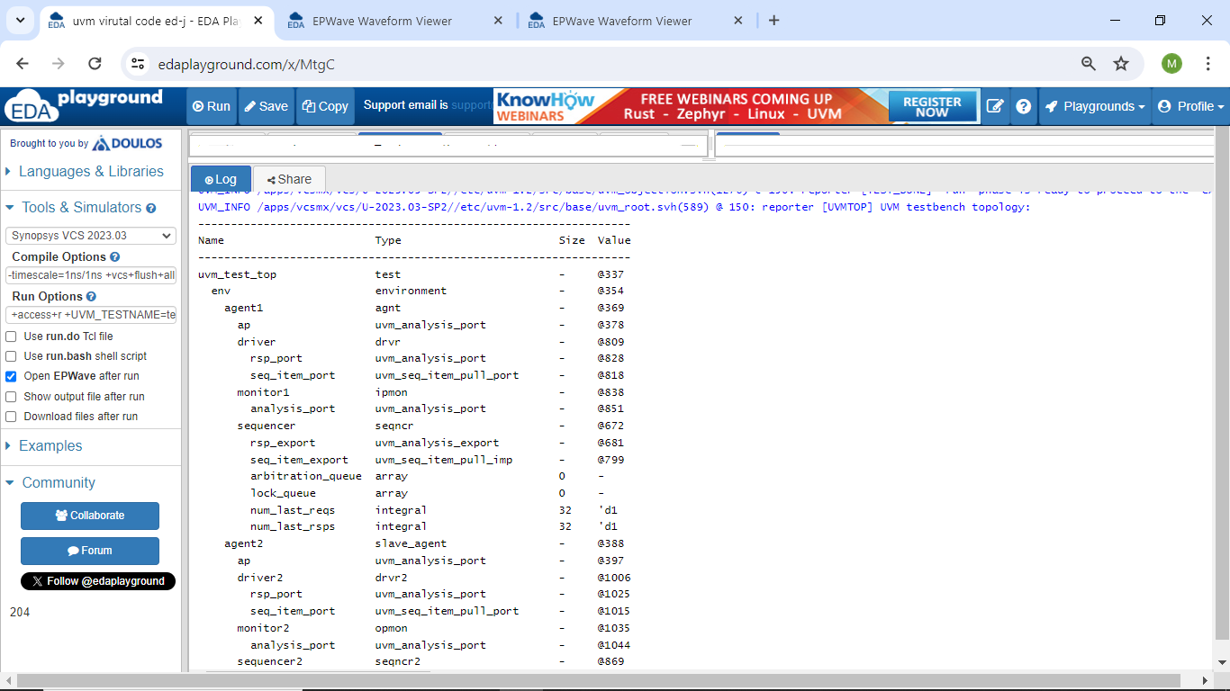
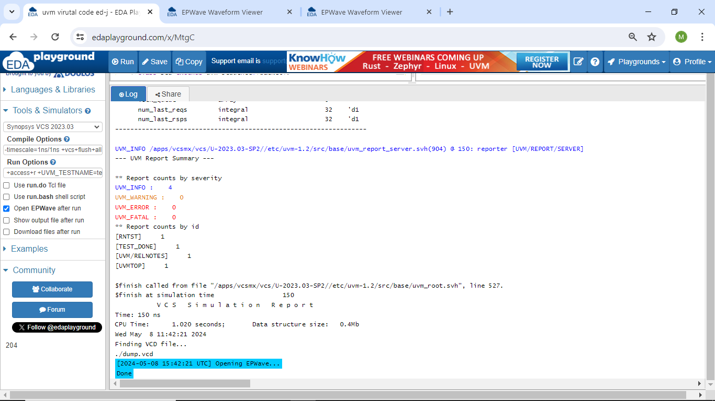
Log Report and Summary

Slide 20
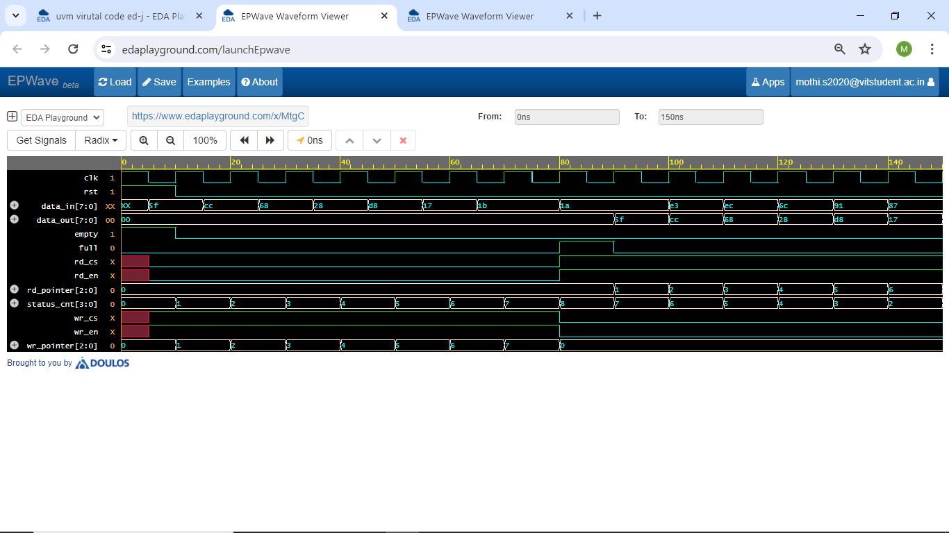
Waveform Output
Empty and Full condition Waveform

Slide 21
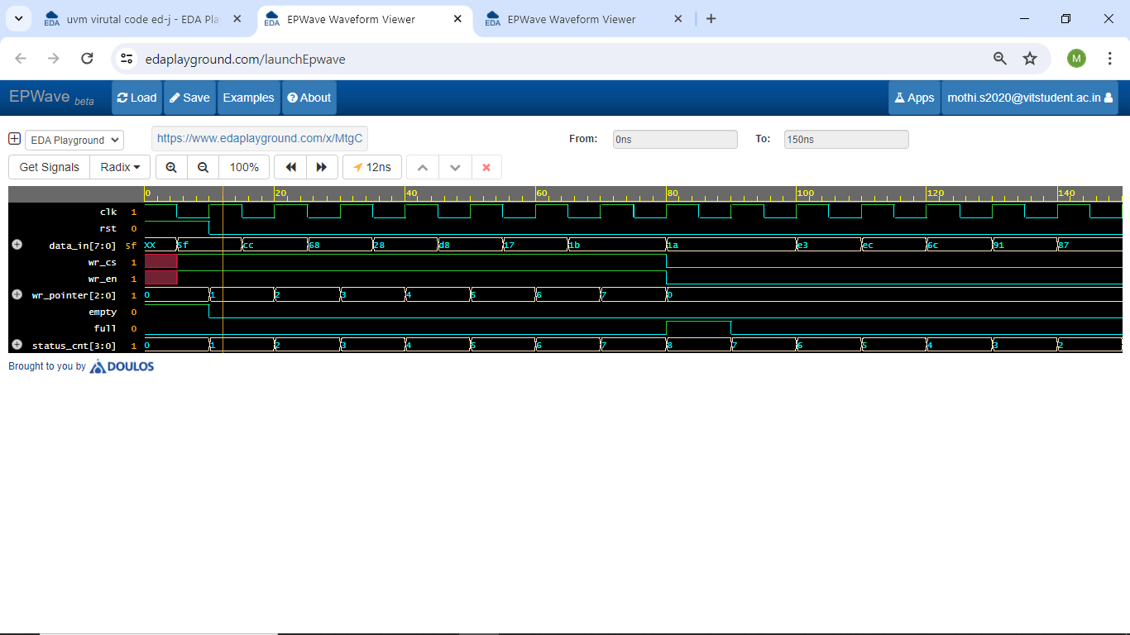
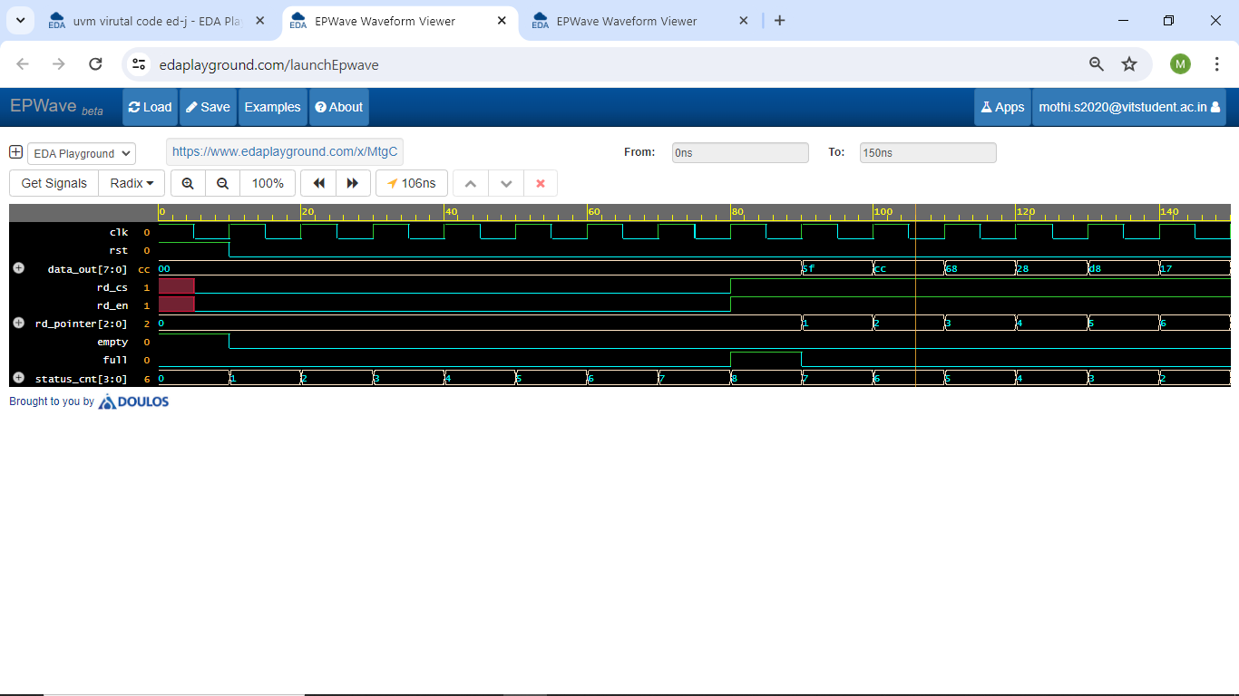
Write Operation Waveform
Read Operation Waveform

Slide 22
CONCLUSION
The project successfully implemented and verified a FIFO memory module using advanced verification methodologies within the Universal Verification Methodology (UVM) framework, integrating a master-slave concept to partition responsibilities between agents. By leveraging techniques such as virtual sequences and assertion-based verification, combined with the master-slave architecture, the project showcased robust functionality and correctness of the FIFO module in a multi-agent environment.

Slide 23
REFERENCES
[1] Apoorva H M and Dr. Kiran Bailey, “UVM based Design Verification of FIFO”, International Journal of Engineering Research & Technology (IJERT), Vol. 9, pp 774-776, 2020.
[2] Agrawal, Navaid Z, Niraj, Rizvi , Rajat Arora, “Implementation and Verification of Synchronous FIFO using System Verilog Verification Methodology”, Journal of Communications Technology, Vol 8, pp 18-23, ISSN 2457-905X, 2015.
[3] Abhishek Jain and Richa Gupta “Expanding the UVM Register Model towards Automation and Simplicity of Use”, International Journal of Advanced Research in Computer Science, Volume 8, No. 3, pp 471-480 2017.
[4] Clifford E. Cummings and Janick Bergeron “Using UVM Virtual Sequencers & Virtual Sequences” World Class System Verilog & UVM Training, DVCon, Vol 8, pp 1-26, 2016

Slide 24
[5] Josep Sans I Prats, “Verification of a microprocessor’s memory pipeline with UVM” Final Master Thesis Master in Innovation and Research in Informatics,Vol 9, pp 1-34, 2022
[6] Bidisha Kashyap and Ravi V “Universal Verification Methodology Based Verification of UART Protocol” National Science, Engineering and Technology Conference (NCSET), pp 1-6, 2020
[7] Khaled Fathy and Khaled Salah “An Efficient Scenario Based Testing Methodology Using UVM”, 17th International Workshop on Microprocessor and SOC Test and Verification, Vol 1, pp 57-60, 2016.
[8] Agustin Rodriguez, Juan Francesconi J., Pedro M. Julian “UVM Based Testbench Architecture for Unit Verification” Argentine School of Micro-Nanoelectronics, Technology and Applications, Vol 9, pp 89-94, 2014.

Slide 25
[9] Deepika, Jayanthi K Murthy, ”Interrupt Enabled Priority Based Master Slave Communication using SPI Protocol”, International Journal of Innovative Technology and Exploring Engineering (IJITEE), ISSN: 2278-3075 (Online), Volume-9 pp-9-13, July 2020.
[10] CHETAN N, R KRISHNA, “Verification of SPI protocol Single Master Multiple Slaves using Systemverilog and Universal Verification Methodology (UVM)” , International Journal of Engineering Research and Applications(IJERA), Vol. 11, Issue 7, (Series-VI), pp. 01-08, July 2021.

Slide 26
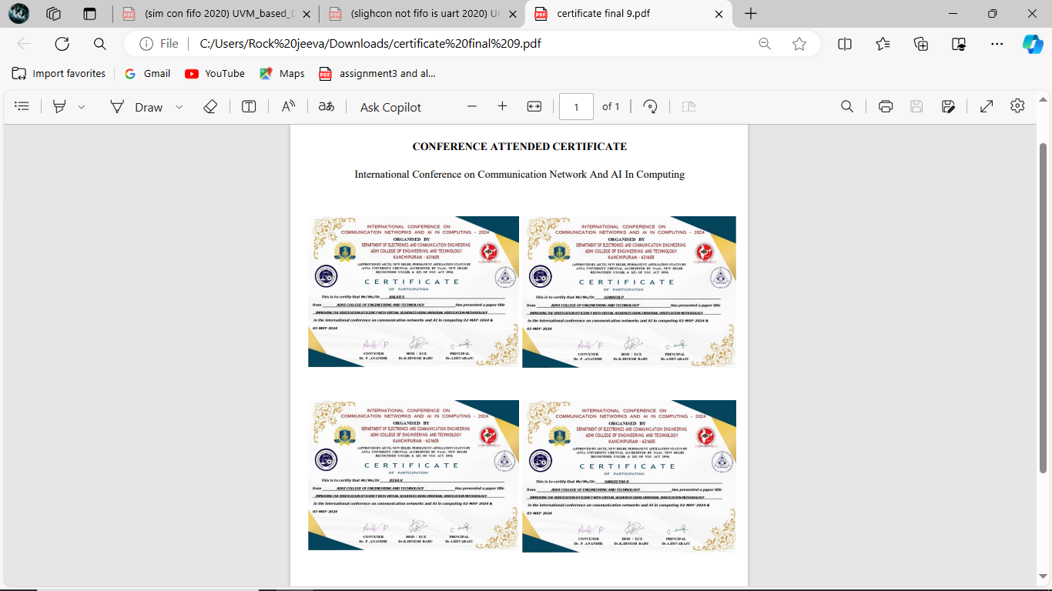

Slide 27

ANY QUERIES?

Slide 28
THANK YOU

